Slide 1
Sorting

Slide 2
Chapter Outline
How to implement these sorting algorithms:
  Selection sort
  Bubble sort
  Insertion sort
  Shell sort
  Merge sort
  Heapsort
  Quicksort

Slide 3
Chapter Outline (2)
Understand the performance of these algorithms
  Which to use for small arrays
  Which to use for medium arrays
  Which to use for large arrays

Slide 4
Using Java API Sorting Methods
Java API provides a class Arrays with several overloaded sort methods for different array types
Class Collections provides similar sorting methods
Sorting methods for arrays of primitive types:
    Based on the Quicksort algorithm
Method of sorting for arrays of objects (and List):
    Based on Mergesort
In practice you would tend to use these
    In this class, you will implement some yourself

Slide 5
Java API Sorting Interface
Arrays methods:
public static void sort (int[] a)
public static void sort (Object[] a)
// requires Comparable
public static <T> void sort (T[] a,
Comparator<? super T> comp)
// uses given Comparator
These also have versions giving a fromIndex/toIndex range of elements to sort

Slide 6
Java API Sorting Interface (2)
Collections methods:
public static <T extends Comparable<T>>
void sort (List<T> list)
public static <T> void sort (List<T> l,
Comparator<? super T> comp)
Note that these are generic methods, in effect having different versions for each type T
  In reality, there is only one code body at run time

Slide 7
Using Java API Sorting Methods
int[] items;
Arrays.sort(items, 0, items.length / 2);
Arrays.sort(items);
public class Person
implements Comparable<Person> { ... }
Person[] people;
Arrays.sort(people);
// uses Person.compareTo
public class ComparePerson
implements Comparator<Person> { ... }
Arrays.sort(people, new ComparePerson());
// uses ComparePerson.compare

Slide 8
Using Java API Sorting Methods (2)
List<Person> plist;
Collections.sort(plist);
// uses Person.compareTo
Collections.sort(plist,
new ComparePerson());
// uses ComparePerson.compare

Slide 9
Conventions of Presentation
Write algorithms for arrays of Comparable objects
For convenience, examples show integers
  These would be wrapped as Integer; or
  You can implement separately for int arrays
Generally use n for the length of the array
  Elements 0 through n-1

Slide 10
Selection Sort
A relatively easy to understand algorithm
Sorts an array in passes
  Each pass selects the next smallest element
  At the end of the pass, places it where it belongs
Efficiency is O(n²), hence called a quadratic sort
Performs:
  O(n²) comparisons
  O(n) exchanges (swaps)

Slide 11
Selection Sort Algorithm
for fill = 0 to n-2 do // steps 2-6 form a pass
set posMin to fill
for next = fill+1 to n-1 do
if item at next < item at posMin
set posMin to next
Exchange item at posMin with one at fill

Slide 12
Selection Sort Example
35 65 30 60 20 scan 0-4, smallest 20
swap 35 and 20
20 65 30 60 35 scan 1-4, smallest 30
swap 65 and 30
20 30 65 60 35 scan 2-4, smallest 35
swap 65 and 35
20 30 35 60 65 scan 3-4, smallest 60
swap 60 and 60
20 30 35 60 65 done

Slide 13
Selection Sort Code
public static <T extends Comparable<T>>
void sort (T[] a) {
int n = a.length;
for (int fill = 0; fill < n-1; fill++) {
int posMin = fill;
for (int nxt = fill+1; nxt < n; nxt++)
if (a[nxt].compareTo(a[posMin])<0)
posMin = nxt;
T tmp = a[fill];
a[fill] = a[posMin];
a[posMin] = tmp;
}
}

Slide 14
Bubble Sort
Compares adjacent array elements
  Exchanges their values if they are out of order
Smaller values bubble up to the top of the array
  Larger values sink to the bottom

Slide 15
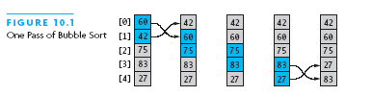
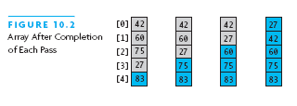
Bubble Sort Example

Slide 16
Bubble Sort Algorithm
do
for each pair of adjacent array elements
if values are out of order
Exchange the values
while the array is not sorted

Slide 17
Bubble Sort Algorithm, Refined
do
Initialize exchanges to false
for each pair of adjacent array elements
if values are out of order
Exchange the values
Set exchanges to true
while exchanges

Slide 18
Analysis of Bubble Sort
Excellent performance in some cases
  But very poor performance in others!
Works best when array is nearly sorted to begin with
Worst case number of comparisons: O(n²)
Worst case number of exchanges: O(n²)
Best case occurs when the array is already sorted:
  O(n) comparisons
  O(1) exchanges (none actually)

Slide 19
Bubble Sort Code
int pass = 1;
boolean exchanges;
do {
exchanges = false;
for (int i = 0; i < a.length-pass; i++)
if (a[i].compareTo(a[i+1]) > 0) {
T tmp = a[i];
a[i] = a[i+1];
a[i+1] = tmp;
exchanges = true;
}
pass++;
} while (exchanges);

Slide 20
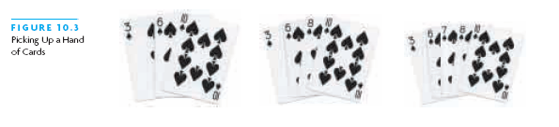
Insertion Sort
Based on technique of card players to arrange a hand
  Player keeps cards picked up so far in sorted order
  When the player picks up a new card
    Makes room for the new card
    Then inserts it in its proper place

Slide 21
Insertion Sort Algorithm
For each element from 2nd (nextPos = 1) to last:
  Insert element at nextPos where it belongs
  Increases sorted subarray size by 1
To make room:
  Hold nextPos value in a variable
  Shuffle elements to the right until gap at right place

Slide 22
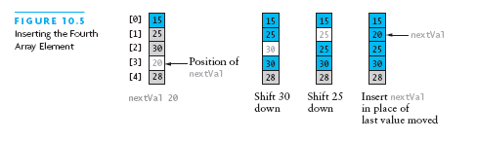
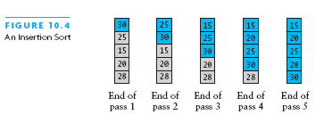
Insertion Sort Example
Chapter 10: Sorting

Slide 23
Insertion Sort Code
public static <T extends Comparable<T>>
void sort (T[] a) {
for (int nextPos = 1;
nextPos < a.length;
nextPos++) {
insert(a, nextPos);
}
}

Slide 24
Insertion Sort Code (2)
private static <T extends Comparable<T>>
void insert (T[] a, int nextPos) {
T nextVal = a[nextPos];
while
(nextPos > 0 &&
nextVal.compareTo(a[nextPos-1]) < 0){
a[nextPos] = a[nextPos-1];
nextPos--;
}
a[nextPos] = nextVal;
}

Slide 25
Analysis of Insertion Sort
Maximum number of comparisons: O(n²)
In the best case, number of comparisons: O(n)
# shifts for an insertion = # comparisons - 1
  When new value smallest so far, # comparisons
A shift in insertion sort moves only one item
  Bubble or selection sort exchange: 3 assignments

Slide 26
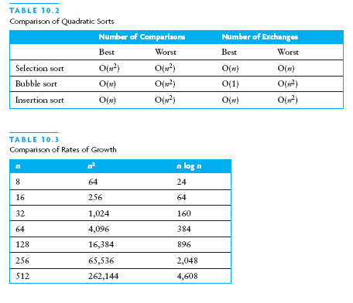
Comparison of Quadratic Sorts
None good for large arrays!

Slide 27
Shell Sort: A Better Insertion Sort
Shell sort is a variant of insertion sort
  It is named after Donald Shell
  Average performance: O(n^{3/2}) or better
Divide and conquer approach to insertion sort
  Sort many smaller subarrays using insertion sort
  Sort progressively larger arrays
  Finally sort the entire array
These arrays are elements separated by a gap
  Start with large gap
  Decrease the gap on each “pass”

Slide 28




Shell Sort: The Varying Gap
Before and after sorting with gap = 7
Before and after sorting with gap = 3

Slide 29
Analysis of Shell Sort
Intuition:
  Reduces work by moving elements farther earlier
Its general analysis is an open research problem
Performance depends on sequence of gap values
For sequence 2^{k}, performance is O(n²)
Hibbard’s sequence (2^{k}-1), performance is O(n^{3/2})
We start with n/2 and repeatedly divide by 2.2
  Empirical results show this is O(n^{5/4}) or O(n^{7/6})
  No theoretical basis (proof) that this holds

Slide 30
Shell Sort Algorithm
Set gap to n/2
while gap > 0
for each element from gap to end, by gap
Insert element in its gap-separated sub-array
if gap is 2, set it to 1
otherwise set it to gap / 2.2

Slide 31
Shell Sort Algorithm: Inner Loop
3.1 set nextPos to position of element to insert
3.2 set nextVal to value of that element
3.3 while nextPos > gap and
element at nextPos-gap is > nextVal
3.4 Shift element at nextPos-gap to nextPos
3.5 Decrement nextPos by gap
3.6 Insert nextVal at nextPos

Slide 32
Shell Sort Code
public static <T extends <Comparable<T>>
void sort (T[] a) {
int gap = a.length / 2;
while (gap > 0) {
for (int nextPos = gap;
nextPos < a.length; nextPos++)
insert(a, nextPos, gap);
if (gap == 2)
gap = 1;
else
gap = (int)(gap / 2.2);
}
}

Slide 33
Shell Sort Code (2)
private static <T extends Comparable<T>>
void insert
(T[] a, int NextPos, int gap) {
T val = a[nextPos];
while ((nextPos >= gap) &&
(val.compareTo(a[nextPos-gap])<0)) {
a[nextPos] = a[nextPos-gap];
nextPos -= gap;
}
a[nextPos] = val;
}

Slide 34
Merge Sort
A merge is a common data processing operation:
  Performed on two sequences of data
    Items in both sequences use same compareTo
    Both sequences in ordered of this compareTo
Goal: Combine the two sorted sequences in one larger sorted sequence
Merge sort merges longer and longer sequences

Slide 35
Merge Algorithm (Two Sequences)
Merging two sequences:
  Access the first item from both sequences
  While neither sequence is finished
    Compare the current items of both
    Copy smaller current item to the output
    Access next item from that input sequence
  Copy any remaining from first sequence to output
  Copy any remaining from second to output

Slide 36
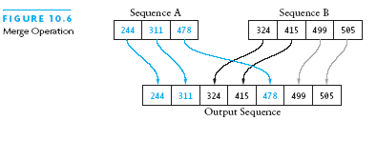
Picture of Merge

Slide 37
Analysis of Merge
Two input sequences, total length n elements
  Must move each element to the output
  Merge time is O(n)
Must store both input and output sequences
  An array cannot be merged in place
  Additional space needed: O(n)

Slide 38
Merge Sort Algorithm
Overview:
Split array into two halves
Sort the left half (recursively)
Sort the right half (recursively)
Merge the two sorted halves

Slide 39
Merge Sort Algorithm (2)
Detailed algorithm:
if tSize ≤ 1, return (no sorting required)
set hSize to tSize / 2
Allocate LTab of size hSize
Allocate RTab of size tSize – hSize
Copy elements 0 .. hSize – 1 to LTab
Copy elements hSize .. tSize – 1 to RTab
Sort LTab recursively
Sort RTab recursively
Merge LTab and RTab into a

Slide 40
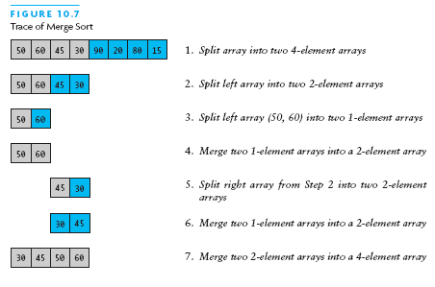
Merge Sort Example
Chapter 10: Sorting

Slide 41
Merge Sort Analysis
Splitting/copying n elements to subarrays: O(n)
Merging back into original array: O(n)
Recursive calls: 2, each of size n/2
  Their total non-recursive work: O(n)
Next level: 4 calls, each of size n/4
  Non-recursive work again O(n)
Size sequence: n, n/2, n/4, ..., 1
  Number of levels = log n
  Total work: O(n log n)

Slide 42
Merge Sort Code
public static <T extends Comparable<T>>
void sort (T[] a) {
if (a.length <= 1) return;
int hSize = a.length / 2;
T[] lTab = (T[])new Comparable[hSize];
T[] rTab =
(T[])new Comparable[a.length-hSize];
System.arraycopy(a, 0, lTab, 0, hSize);
System.arraycopy(a, hSize, rTab, 0,
a.length-hSize);
sort(lTab); sort(rTab);
merge(a, lTab, rTab);
}

Slide 43
Merge Sort Code (2)
private static <T extends Comparable<T>>
void merge (T[] a, T[] l, T[] r) {
int i = 0; // indexes l
int j = 0; // indexes r
int k = 0; // indexes a
while (i < l.length && j < r.length)
if (l[i].compareTo(r[j]) < 0)
a[k++] = l[i++];
else
a[k++] = r[j++];
while (i < l.length) a[k++] = l[i++];
while (j < r.length) a[k++] = r[j++];
}

Slide 44
Heapsort
Merge sort time is O(n log n)
  But requires (temporarily) n extra storage items
Heapsort
  Works in place: no additional storage
  Offers same O(n log n) performance
Idea (not quite in-place):
  Insert each element into a priority queue
  Repeatedly remove from priority queue to array
    Array slots go from 0 to n-1

Slide 45
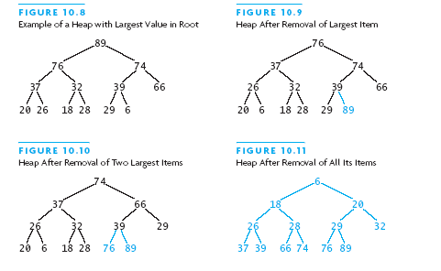
Heapsort Picture

Slide 46
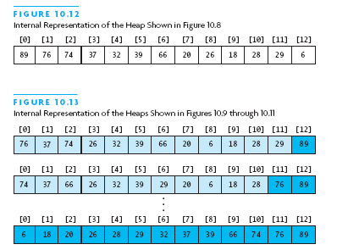
Heapsort Picture (2)

Slide 47
Algorithm for In-Place Heapsort
Build heap starting from unsorted array
While the heap is not empty
  Remove the first item from the heap:
    Swap it with the last item
  Restore the heap property

Slide 48
Heapsort Code
public static <T extends Comparable<T>>
void sort (T[] a) {
buildHp(a);
shrinkHp(a);
}
private static ... void buildHp (T[] a) {
for (int n = 2; n <= a.length; n++) {
int chld = n-1; // add item and reheap
int prnt = (chld-1) / 2;
while (prnt >= 0 &&
a[prnt].compareTo(a[chld])<0) {
swap(a, prnt, chld);
chld = prnt; prnt = (chld-1)/2
} } }

Slide 49
Heapsort Code (2)
private static ... void shrinkHp (T[] a) {
int n = a.length;
for (int n = a.length-1; n > 0; --n) {
swap(a, 0, n); // max -> next posn
int prnt = 0;
while (true) {
int lc = 2 * prnt + 1;
if (lc >= n) break;
int rc = lc + 1;
int maxc = lc;
if (rc < n &&
a[lc].compareTo(a[rc]) < 0)
maxc = rc;
....

Slide 50
Heapsort Code (3)
if (a[prnt].compareTo(a[maxc])<0) {
swap(a, prnt, maxc);
prnt = maxc;
} else {
break;
}
}
}
}
private static ... void swap
(T[] a, int i, int j) {
T tmp = a[i]; a[i] = a[j]; a[j] = tmp;
}

Slide 51
Heapsort Analysis
Insertion cost is log i for heap of size i
  Total insertion cost = log(n)+log(n-1)+...+log(1)
  This is O(n log n)
Removal cost is also log i for heap of size i
  Total removal cost = O(n log n)
Total cost is O(n log n)

Slide 52
Quicksort
Developed in 1962 by C. A. R. Hoare
Given a pivot value:
  Rearranges array into two parts:
    Left part ≤ pivot value
    Right part > pivot value
Average case for Quicksort is O(n log n)
  Worst case is O(n²)

Slide 53




Quicksort Example

Slide 54
Algorithm for Quicksort
first and last are end points of region to sort
if first < last
Partition using pivot, which ends in pivIndex
Apply Quicksort recursively to left subarray
Apply Quicksort recursively to right subarray
Performance: O(n log n) provide pivIndex not always too close to the end
Performance O(n²) when pivIndex always near end

Slide 55
Quicksort Code
public static <T extends Comparable<T>>
void sort (T[] a) {
qSort(a, 0, a.length-1);
}
private static <T extends Comparable<T>>
void qSort (T[] a, int fst, int lst) {
if (fst < lst) {
int pivIndex = partition(a, fst, lst);
qSort(a, fst, pivIndex-1);
qSort(a, pivIndex+1, lst);
}
}

Slide 56
Algorithm for Partitioning
Set pivot value to a[fst]
Set up to fst and down to lst
do
Increment up until a[up] > pivot or up = lst
Decrement down until a[down] <= pivot or
  down = fst
if up < down, swap a[up] and a[down]
while up is to the left of down
swap a[fst] and a[down]
return down as pivIndex

Slide 57
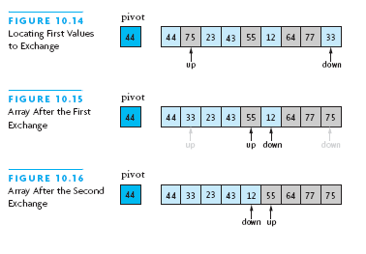
Trace of Algorithm for Partitioning

Slide 58
Partitioning Code
private static <T extends Comparable<T>>
int partition
(T[] a, int fst, int lst) {
T pivot = a[fst];
int u = fst;
int d = lst;
do {
while ((u < lst) &&
(pivot.compareTo(a[u]) >= 0))
u++;
while (pivot.compareTo(a[d]) < 0)
d++;
if (u < d) swap(a, u, d);
} while (u < d);

Slide 59
Partitioning Code (2)
swap(a, fst, d);
return d;
}

Slide 60
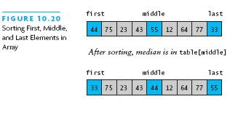
Revised Partitioning Algorithm
Quicksort is O(n²) when each split gives 1 empty array
This happens when the array is already sorted
Solution approach: pick better pivot values
Use three “marker” elements: first, middle, last
Let pivot be one whose value is between the others

Slide 61
Testing Sortiing Algorithms
Need to use a variety of test cases
  Small and large arrays
  Arrays in random order
  Arrays that are already sorted (and reverse order)
  Arrays with duplicate values
Compare performance on each type of array

Slide 62
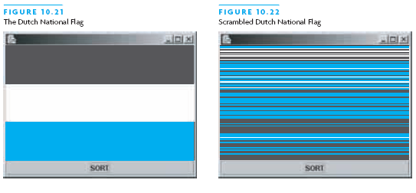
The Dutch National Flag Problem
Variety of partitioning algorithms have been published
One that partitions an array into three segments was introduced by Edsger W. Dijkstra
Problem: partition a disordered three-color flag into three contiguous segments
Segments represent < = > the pivot value
Chapter 10: Sorting

Slide 63
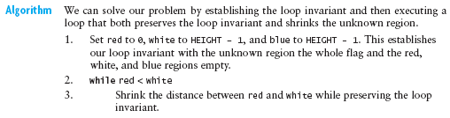
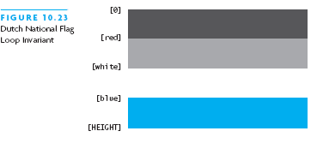
The Dutch National Flag Problem

Slide 64
Chapter Summary
Three quadratic sorting algorithms:
  Selection sort, bubble sort, insertion sort
Shell sort: good performance for up to 5000 elements
Quicksort: average-case O(n log n)
  If the pivot is picked poorly, get worst case: O(n²)
Merge sort and heapsort: guaranteed O(n log n)
  Merge sort: space overhead is O(n)
Java API has good implementations

Slide 65
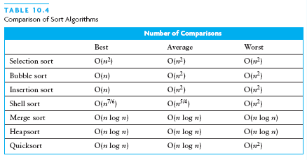
Summary

